Slide 1
Banking Loan & Financial Transaction Automation Testing
Technical Stack Learned & Used:
Programming Language : Java
Automation Tool : Selenium WebDriver
Testing Framework : TestNG
Reporting Tools : TestNG Reports and Extent Reports
Project Management Tool : JIRA
Gopi Krishna
Under the Guidance Of
Mr. Vishal Gupta

Slide 2
ParaBank Web Application
URL : https://parabank.parasoft.com/parabank/index.htm
This website is mainly used to practice automation testing in a banking environment.
ParaBank is a demo online banking site used for learning and testing.
People can open accounts, move money, pay bills, and check their balance or past transactions.
It also gives an option to apply for loans and manage personal finances.

Slide 3
Types of Testing & Tools Used
Types of Testing:
All main features are checked using manual testing.
Automation testing is done with Selenium WebDriver along with TestNG.
Tools & Frameworks:
The project is built and run in Eclipse IDE.
Maven is used to handle project builds and dependencies.
Page Object Model (POM) is followed to keep the test code clean and structured.
ExtentReports helps in creating clear and detailed test reports.
GitLab is used to store and manage code versions.

Slide 4
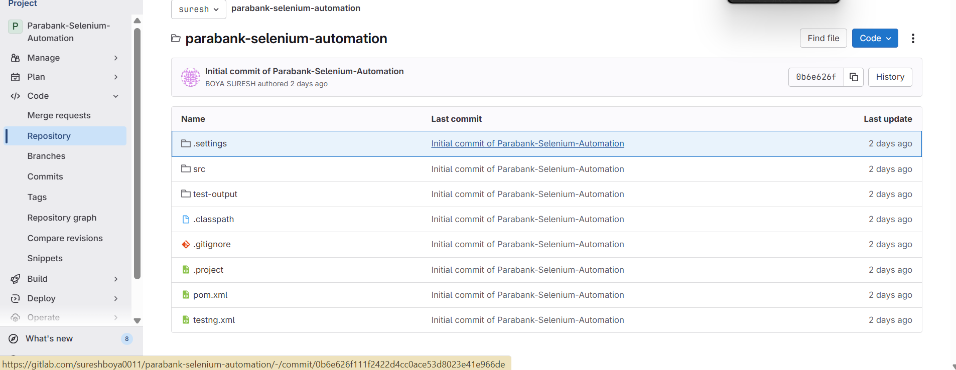
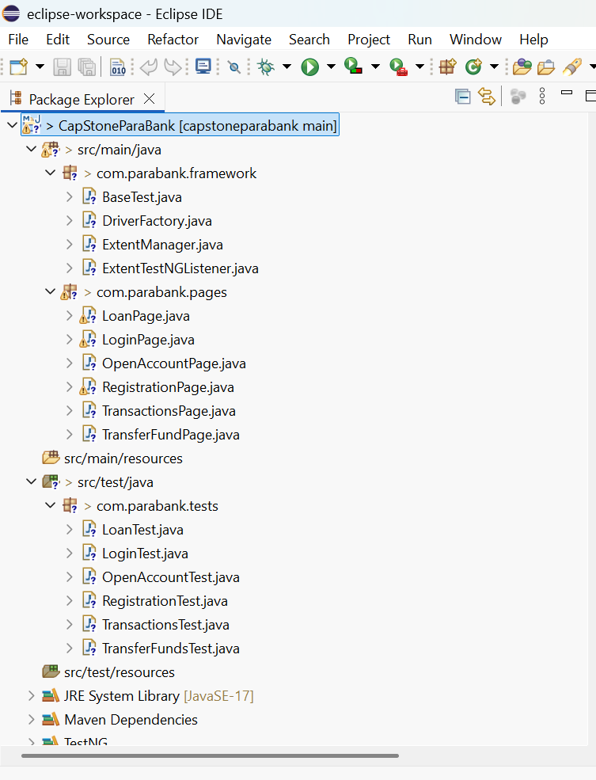
Automation Framework & GitLab Repository
Code Repository on GitLab
Automation Framework in Eclipse IDE

Slide 5
Automation Approach
Created and ran test cases for banking features like account opening,
fund transfer, and loans using Selenium WebDriver with TestNG.
Used Page Object Model (POM) to keep test code clean and reusable.
Managed project builds and dependencies with Maven.
Developed and executed scripts in Eclipse IDE, with TestNG for execution.
Stored project code in GitLab for version control and teamwork.
Generated reports with ExtentReports, including logs and screenshots.

Slide 6
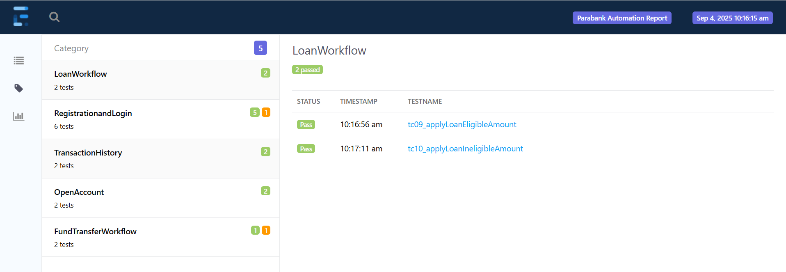
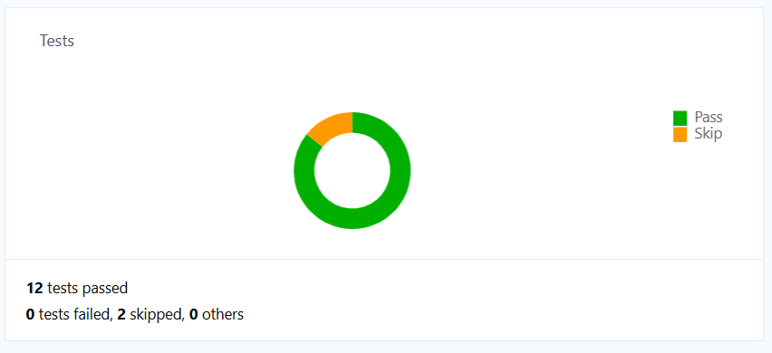
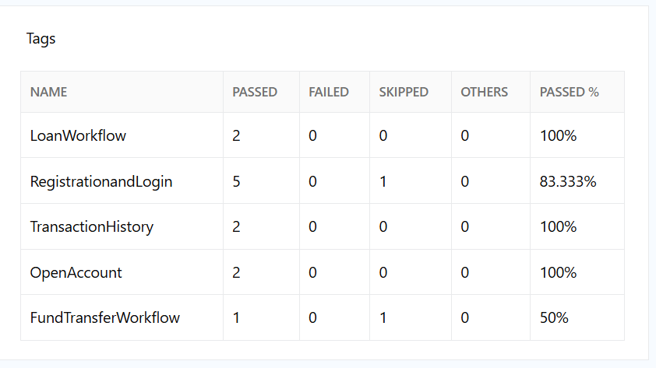

Slide 7
Manual Testing with Zephyr & Jira
Performed manual testing of ParaBank modules using Zephyr inside JIRA.
Wrote test cases for login, registration, money transfer, account creation, and viewing transactions.
Connected each test case with its related user story in JIRA to keep traceability.
Carried out testing sprint by sprint, as per the Scrum workflow.
Grouped test cases into test cycles in Zephyr for every sprint.
Logged bugs in JIRA during testing and linked them back to the related stories and test cases

Slide 8
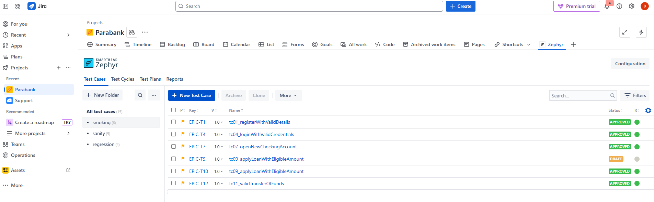
Zephyr Board – Test Cases
Test cases were managed in Zephyr Board.
Created three folders : Sanity , Smoke , Regression
Smoke – Critical flows that must work.

Slide 9
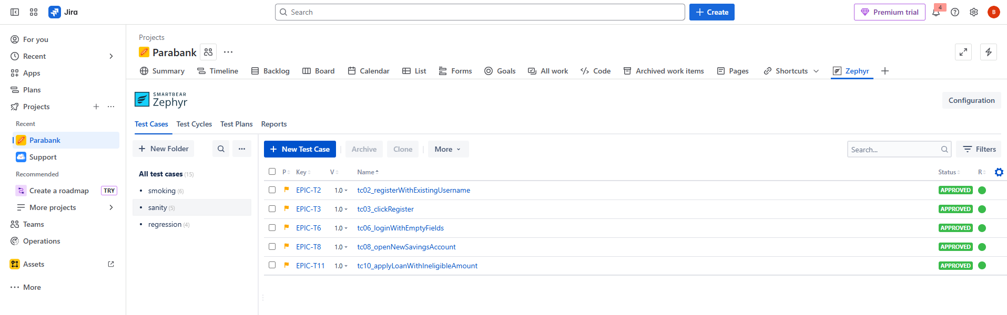
Sanity : Focused checks after changes.
Regression : Selected tests to verify for key features.

Slide 10
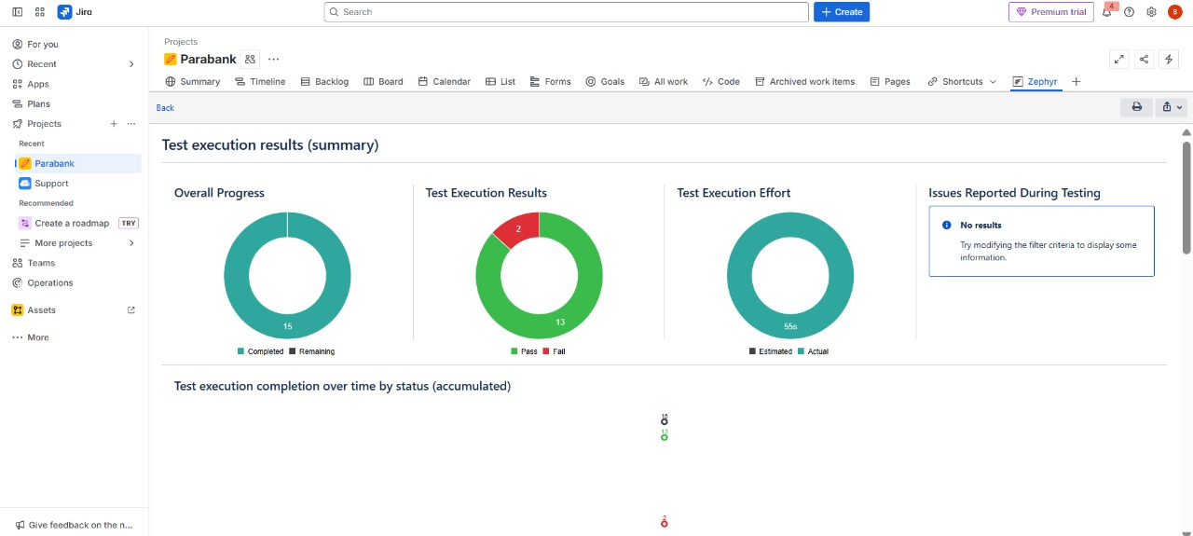
Test Report From Zephyr

Slide 11
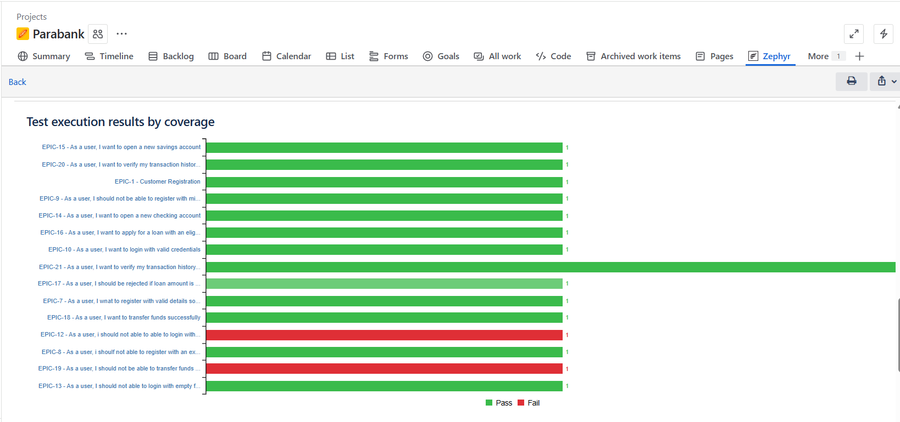

Slide 12


